Slide 1
Governor’s Advisory Board for Telecommunications Relay
April 16, 2021

Slide 2
Director’s Report
David Bahar

Slide 3
TAM Staffing
TAM Finance Director Recruitment: Recruitment has closed, and we are interviewing candidates.
MAT Specialist Recruitment: Anticipate posting within a month.
Director‘s Report
April 16, 2021

Slide 4
Senior Call Check Program Updates
A meeting was held with the Maryland Department of Aging (MDoA) Deputy Secretary Bernice Hutchinson in mid-February, with the primary topic being the accessibility of the Senior Call Check program. TAM identified several areas where there’s a need of improved accessibility and offered resources and support to see those changes implemented.
MDoA has not yet committed to any changes. TAM will continue to proactively reach out with support and encouragement.
Director‘s Report
April 16, 2021

Slide 5
GABTR Update
Welcome to Our Newest GABTR Members:
Michelle Morales
Deaf/Hard of Hearing Community
Sonya Smith
ODHH Representative
Glen Lockhart
Deaf/Hard of Hearing Community
Please take a moment to introduce yourselves!
Director‘s Report
April 16, 2021

Slide 6
Regulatory Matters: Real-Time Text
Despite federal regulations requiring carriers provide RTT calls access to the 7-1-1 dialing code (Title 47 Section 64.603) and requiring carriers to support the capability to “initiate and receive RTT calls to and from the same telephone numbers for which voice calls can be initiated and received,” (47 CFR Sec. 67.2) these carriers are currently unable to support end to end RTT calls dialed to 7-1-1.
Today, any RTT call dialed to 7-1-1 will be downgraded to a TTY call (as RTT is backwards compatible with TTY) with none of the benefits offered by a native RTT call, such as simultaneous two way typing and simultaneous text and audio.
TAM has shared this information with the Federal Communications Commission and has reached out to the CTIA—the wireless association that works closely with the carriers to encourage steps towards compliance.
Director‘s Report
April 16, 2021

Slide 7
Questions?

Slide 8
Manager Report
Travis Dougherty
Maryland Relay Manager
travis.dougherty@maryland.gov | 202-753-9119 (VP)

Slide 9
RTT Revolution
Maryland Relay Manager Report
April 16, 2021

Slide 10
RCC Minutes
RCC minutes by month from March 2020 to March 2021
8385
7605
4440
3795
3780
3810
2655
2145
2355
555
N/A
N/A
90
March
2020
April
2020
May
2020
June
2020
July
2020
August
2020
September
2020
October
2020
November
2020
December
2020
January 2021
February 2021
March 2021
Maryland Relay Manager Report
April 16, 2021

Slide 11
RCC
RCC Guideline Focus Group
RCC Panel Discussion
Maryland Relay Manager Report
April 16, 2021

Slide 12
Questions?

Slide 13
MAT Manager Report
Kevin Steffy

Slide 14
General Updates
From January to March 2021, MAT has received 48 new applications and distributed a total of 59 pieces of telecommunications equipment
In the previous quarterly report, we distributed a total of 115 pieces of telecommunications equipment
There is a difference of 56 equipment pieces between the previous and current quarters
Evaluators are still doing the evaluations, re-evaluations, and troubleshooting remotely as much as possible.
We are still performing our services remotely to protect the health of our staff and our clients. If we must meet with clients in person as a last resource, it is with the understanding that we must use PPE and ensure that everything is properly sanitized
Until further notice, most of the senior and nursing centers are still not allowing evaluators to come in for assessments
MAT Manger Report
April 16, 2021

Slide 15
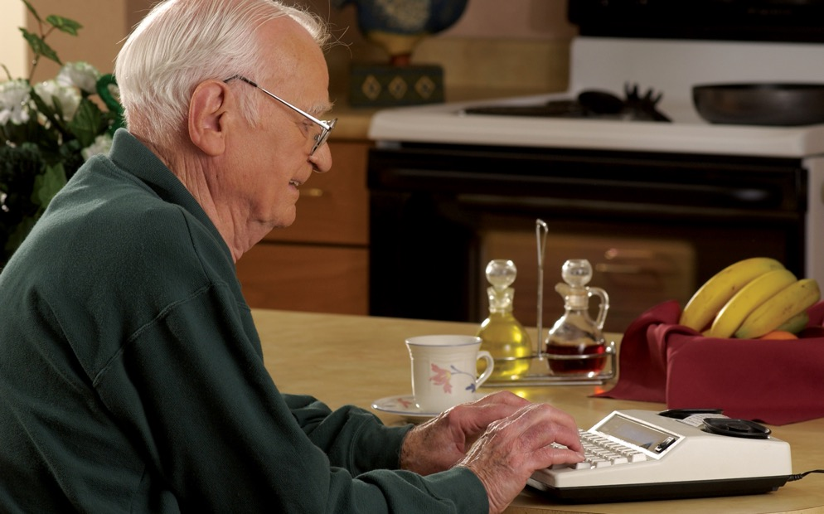
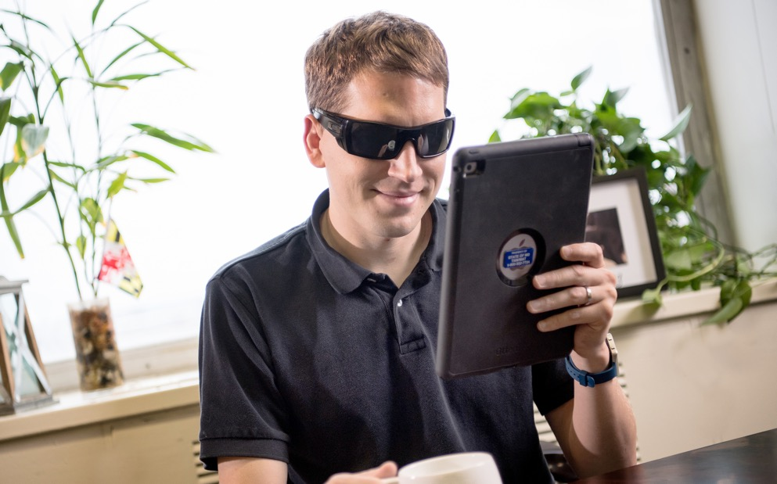
Equipment Update
Below are the numbers for distributed equipment from January to March 2021
Amplified Phone: 12
Amplified Phone with Amplified Voice Output: 1
Captioned Telephone: 11
Hands-Free Phone: 1
iPad: 28
Synthetic Speech System: 1
Wireless Device: 13
MAT Manger Report
April 16, 2021

Slide 16
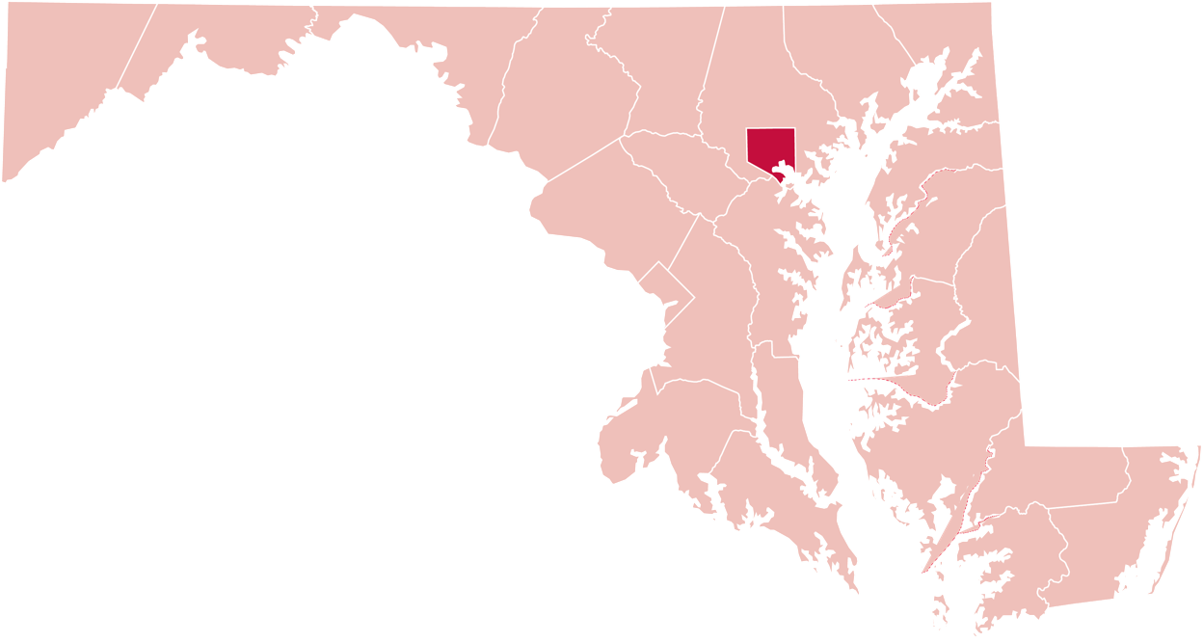
Equipment Update
Below are the numbers for distributed equipment by county from January to March 2021
Allegany County
1
19
Baltimore County
1
Baltimore City
Garrett County
7
6
Harford County
Washington County
6
5
2
Anne Arundel County
Frederick County
1
Caroline County
Howard County
6
2
Wicomico County
Prince George’s County
3
MAT Manger Report
April 16, 2021

Slide 17
Equipment Update
Below are the numbers for distributed equipment from July 2020 to March 2021
Amplified Answering Machine: 1
Amplified Phone: 134
Amplified Phone with Amplified Voice Output: 7
Captioned Telephone: 26
Hands-Free Phone: 2
iPad: 83
Memory Dialing Aid: 1
Miscellaneous: 1
Phone Ring Signaler: 1
Synthetic Speech System: 1
Wireless Device: 15
MAT Manger Report
April 16, 2021

Slide 18
Equipment Update
Below are the numbers for distributed equipment by county from July to December 2020
Allegany County
2
Carroll County
4
53
Baltimore County
1
Cecil County
1
Baltimore City
10
Harford County
Garrett County
37
Washington County
17
2
Queen Anne’s County
Frederick County
14
4
Talbot County
Montgomery County
7
1
Calvert County
Howard County
11
2
Dorchester County
Prince George’s County
12
4
Wicomico County
St Mary’s County
4
4
Worcester County
MAT Manger Report
Anne Arundel County
11
April 16, 2021

Slide 19
Focus Groups
We hosted four of our virtual focus group webinars for different groups on different dates:
Low Vision/Blind
Cognitive
Speech
Mobility
Brenda Bush, Janet Parke, Betsy Hein, and I hosted and ran the webinars with several pieces of equipment for each group.
MAT Manger Report
April 16, 2021

Slide 20
Focus Groups
Equipment for Speech
Equipment for Low Vision/Blind
3 Pieces of Equipment and 5 Apps
1: Dedicated Device–Proloquo2Go, TouchTalk and TobiDynavox
2: App Options–Proloquo4Text, QuickTalk, TouchChat, SonoFlex, and Voiceitt
4 participators showed up
AmpliTalk, BlindShell Classic, and Future Call
5 participators showed up
Equipment for Cognitive
Equipment for Mobility
Picture Phone, KidsConnect KC2, RAZ Mobility Memory Phone, Jitterbug Flip, and GrandPad
5 participators showed up
Nest Hub Max, Future Call, GlassOuse, and Echo Show
Those webinars were successful. I am looking forward to hosting the last two with the Deaf and Deaf-Blind groups.
MAT Manger Report
April 16, 2021

Slide 21
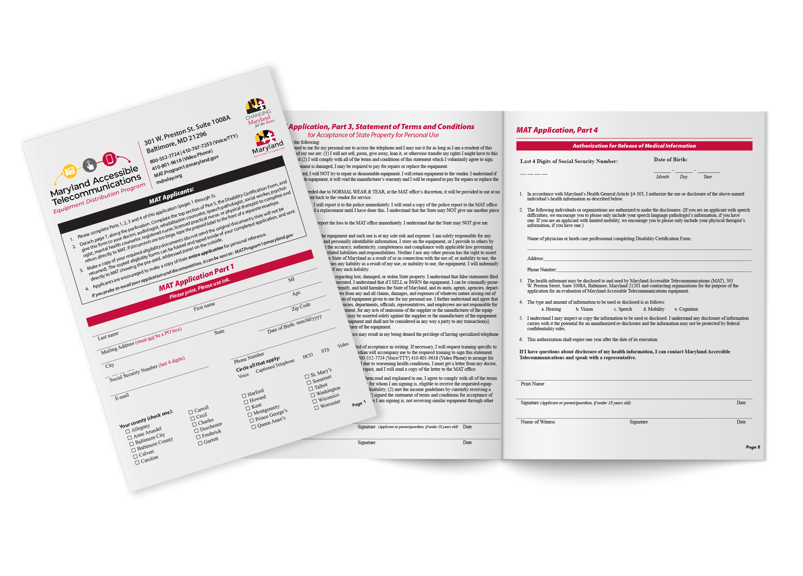
MAT Application Form
Devaney & Associates, Donna Broadway-Callaman, and I have been working to revise the MAT application. It is finished and was printed in January. It has also been distributed.
MAT Manger Report
April 16, 2021

Slide 22
Assistance Telecommunications Equipment (ATE)
Assistance Telecommunications Equipment (ATE) Request for Approval (RFP)
Director‘s Report
April 16, 2021

Slide 23
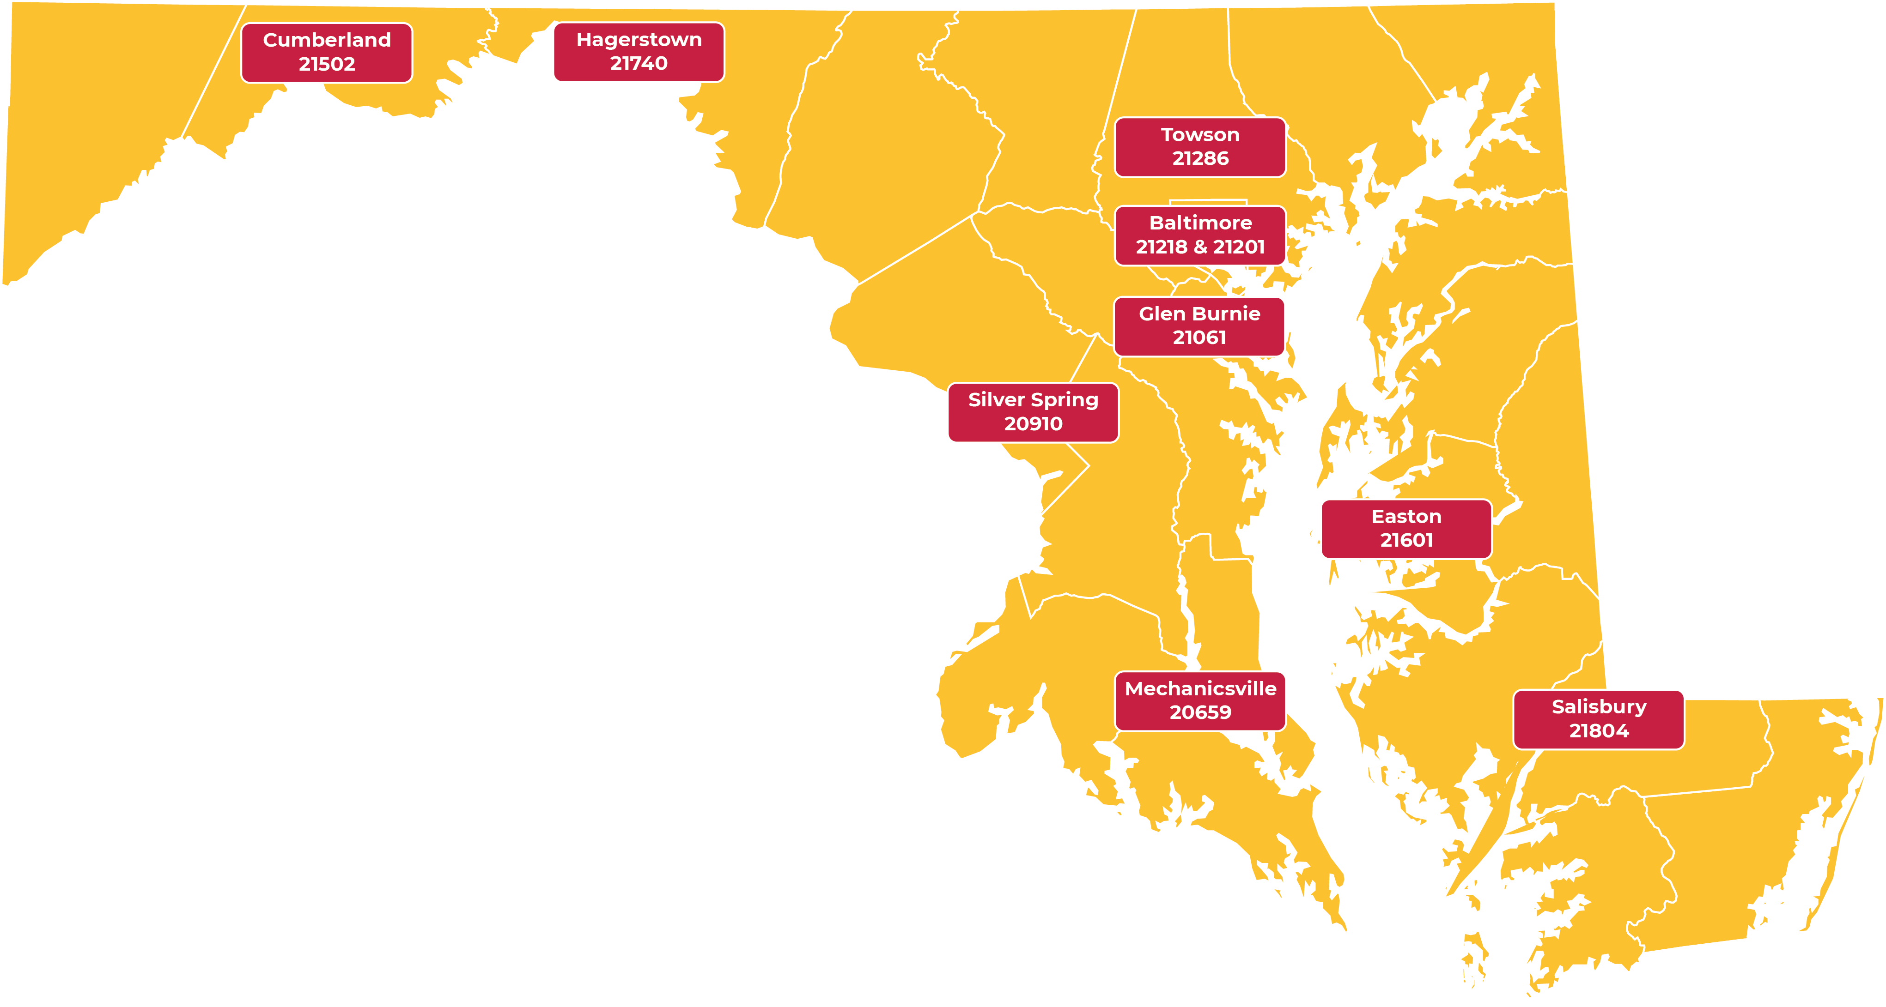
Evaluation Centers
MDTAP
Northeastern Area
Director‘s Report
April 16, 2021

Slide 24
Questions?

Slide 25
Public Relations & Outreach Report
Donna Broadway-Callaman
Community Outreach Manager
donnat.broadway-callaman@maryland.gov | 410-582-6158

Slide 26
What’s New With Maryland Relay?
We have finished the majority of our rebranding efforts and we are now focused on updating our website—which is currently under DoIT but will be transitioning to DoD soon. Currently, we are making edits to the website and we are planning a full revamp once it is transferred to DoD.
There has been a delay in updating both sites, due to the individuals working on our website being reassigned to COVID-19-related work and vaccination roll out. Since that is slowing down, members of both website teams are now available to work on our websites.
Currently, I do not know when both websites will be updated. We recently met with members of the DoD website team to restart the process. As of right now, we do not have any other meetings scheduled.
Public Relations & Outreach Report
April 16, 2021

Slide 27
What’s New With Maryland Relay?
There is a possibility that in-person events will start again as the Maryland Municipal League conference is scheduled for a hybrid event in late June/July and the Maryland Association of Counties is scheduled for an in-person event in August.
Even though restrictions are being lifted and Governor Hogan expects a sense of normalcy by Memorial Day or June, the outreach coordinators have not been cleared to return to in-person events and TAM will not require them to attend in-person events until they are comfortable.
Public Relations & Outreach Report
April 16, 2021

Slide 28
What’s New With Maryland Relay?
We are working with the MAT program to promote CapTel and other MAT services. We have created new collateral and are working on Lunch and Learn programs that will be available in each county and Baltimore City.
We are also working on creating the wrap for the new van and updating our tablecloths, banner stands, and table runners for when in- person outreach officially begins again.
Public Relations & Outreach Report
April 16, 2021

Slide 29
How Maryland Relay is Staying Connected During COVID-19
Advertising
Webinars
Mailings
Virtual events
Networking/making new contacts
Public Relations & Outreach Report
April 16, 2021

Slide 30
Questions?

Slide 31
Hamilton Relay
Updates

Slide 32
Maryland TRS
Percent Answered in 10 seconds
Hamilton Relay Report
April 16, 2021

Slide 33
Maryland Captioned Telephone
Percent Answered in 10 seconds
Hamilton Relay Report
April 16, 2021

Slide 34
Maryland TRS
Session & Conversation Minutes
Hamilton Relay Report
April 16, 2021

Slide 35
Maryland Captioned Telephone
Session & Conversation Minutes
Hamilton Relay Report
April 16, 2021

Slide 36
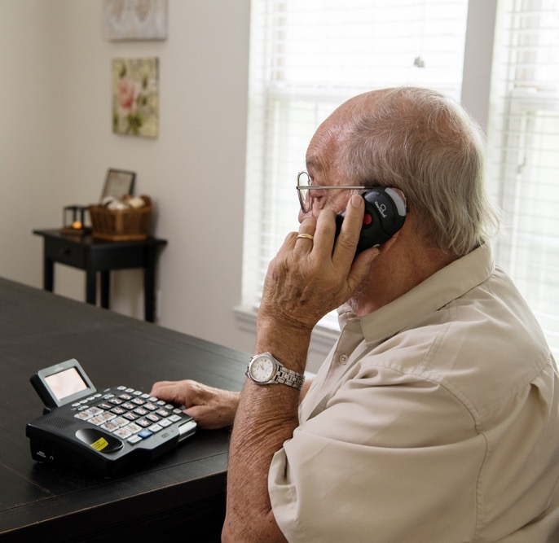
Maryland TRS
Customer Care Contacts
 | December | January | February
Technical | 0 | 0 | 1
General Information | 8 | 19 | 8
Equipment | 3 | 3 | 4
Customer Profile | 2 | 1 | 3
Outreach | 0 | 1 | 0
Operations Complaints | 0 | 0 | 1
External Complaints | 0 | 0 | 0
Wrong Number/Hang Up | 40 | 72 | 54
Compliments/Commendations | 0 | 0 | 0
Malicious Caller | 0 | 0 | 0
Hamilton Relay Report
April 16, 2021

Slide 37
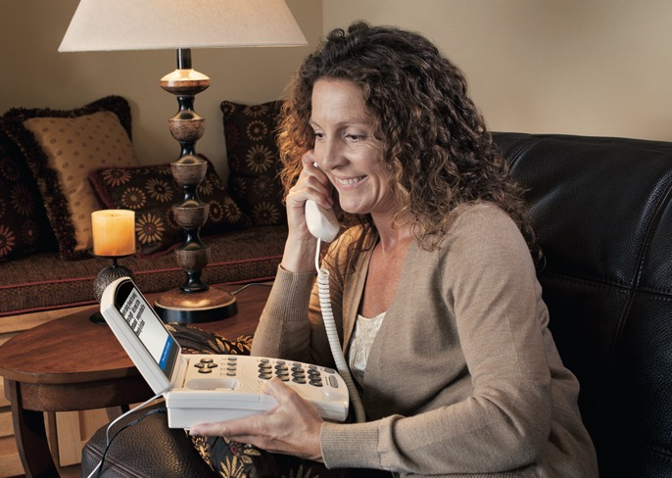
Maryland Captioned Telephone
Customer Care Contacts
 | December | January | February
Service | 0 | 0 | 0
Technical | 0 | 0 | 0
Product | 0 | 0 | 0
Billing | 0 | 0 | 0
Setup | 0 | 4 | 0
Info/Referral/Ed | 0 | 0 | 0
Other | 0 | 0 | 0
Hamilton Relay Report
April 16, 2021

Slide 38
Outreach Highlights
PrimeTime Article
Presentation for the 911 Board Sub-Committee
Collaboration with Deirdre Lynch
Hamilton Relay Report
April 16, 2021

Slide 39
Outreach Call to Action
B’More Healthy Expo interview will air throughout April. Be sure to look for it!
Collaboration with GABTR board members to reach more community members
Better Hearing and Speech Month nominees were due on Friday, April 9, 2021 but we have received an extension. We want to ensure we have an award winner in Maryland.
Hamilton Relay Report
April 16, 2021

Slide 40
Questions?

Slide 41
Thank you!
April 16, 2021

